Slide 1
Center for Faculty Excellence Loyola University Chicago
Every Semester Needs a plan*
Facilitated by: Christine Pajunar Li-Grining, Ph.D. Director, Center for Faculty Excellence
*developed in conjunction with the National Center for Faculty Development and Diversity

Slide 2
Today’s FacilitatorS
Badia Ahad, Ph.D.
Vice Provost for Faculty Affairs
Professor, Dept. of English
National Center for Faculty Development and Diversity Director of Training and Head Faculty Development Coach (2011-2020)
Faculty Development Consultant for over 15 universities/coached over 2000 faculty across disciplines, ranks, and institutional types
LUC Center for Faculty Excellence

Slide 3
National Center For Faculty Development and Diversity Core Curriculum
Every semester needs a plan
Manage stress & rejection
Develop a daily writing practice
Strategic Planning
Healthy Relationships
Explosive Productivity
Work-Life Balance
Engage in healthy conflict
Overcome academic perfectionism
Thriving
In the academy
Cultivate a network of mentors & sponsors
Move from resistance to writing
The art of saying “no”
Align your time with your priorities
Master academic time management
LUC Center for Faculty Excellence

Slide 4
The Challenges of the “Semester Slam” are:
Varied and time-consuming commitments
The tendency to unconsciously prioritize seemingly urgent, unimportant tasks and other needs while neglecting our own health, well-being, relationships, and long-term success
Lack of clarity about how much time research and writing tasks actually take
Institutional cultures where everyone works all the time
LUC Center for Faculty Excellence

Slide 5
The keys to a successful semester are:
Knowing what you need as a human being and what you need to accomplish as a researcher and writer
Creating a realistic plan to meet ALL of your needs
Building and/or connecting with the type of support and accountability that will sustain and motivate you through the ups and downs of the semester
LUC Center for Faculty Excellence

Slide 6
Creating your strategic plan
LUC Center for Faculty Excellence

Slide 7
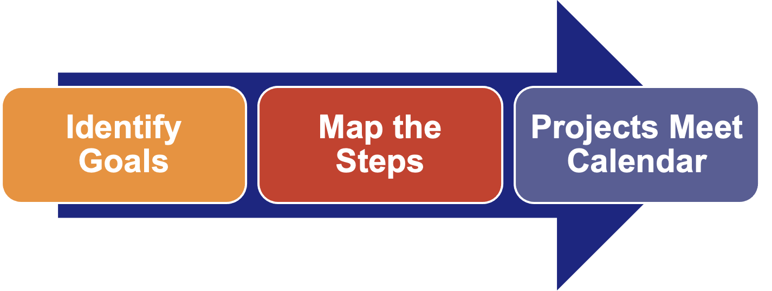
The planning process
It requires knowing WHAT, HOW, and WHEN
LUC Center for Faculty Excellence

Slide 8
Step #1: Identify Your Goals (5 Minutes)
Project Goals:
_______________________________________
_______________________________________
_______________________________________
Personal Goals:
_______________________________________
_______________________________________
_______________________________________
LUC Center for Faculty Excellence

Slide 9
Let’s pause…are your goals:
For example:
Typical personal goal: Improve my fitness level
Typical professional goal: Work on article manuscript
SMART goal (personal):
Walk at least 10,000 steps per day, Monday – Friday, from today until the last day of the term.
SMART goal (professional):
Read relevant literature on X and draft lit review by the end of May 2021
Specific
Measurable
Attractive
Realistic
Time-Framed
So, take 7-10 minutes to re-read and revise your goals into SMART goals.
LUC Center for Faculty Excellence
LUC Center for Faculty Excellence

Slide 10
Step #2: Map out the steps (example)
To-Do Task: Download and skim recent abstracts from 3 top choice journal outlets
Project:
Draft Lit Review
Project:
Draft Method and Results
Research 3 possible journal outlets
Project:
Draft Discussion
To-Do Task: Read editor statements for each journal
GOAL:
Submit Manuscript
Project:
Select a Journal
To-Do Task: Make a coffee date with X
Ask colleagues for advice
To-Do Task: E-mail Y
Search for any special issue journal calls that are relevant to topic
LUC Center for Faculty Excellence

Slide 11
Step #2: Map out the steps (it’s your turn!)
LUC Center for Faculty Excellence

Slide 12
Step #3: Introduce your PROJECTS to your calendar (example)
MONTH | WEEK | PROJECT GOALS | PERSONAL TASKS
 | Week 1 |  | Walk 10,000 Steps, Sleep 8 Hrs
 | Week 2 | Draft Lit Review [project 1] | Walk 10,000 Steps, Sleep 8 Hrs
 | Week 3 | Draft Lit Review [project 1] | Walk 10,000 Steps, Sleep 8 Hrs
 | Week 4 | Draft Methods & Results [project 2] | Walk 10,000 Steps, Sleep 8 Hrs
 | Week 5 | Draft Discussion [project 3] | Walk 10,000 Steps, Sleep 8 Hrs
 | Week 6 | TRAVEL Send draft to co-author | Walk 10,000 Steps, Sleep 8 Hrs
 | Week 7 | Select a Journal [project 4] | Walk 10,000 Steps, Sleep 8 Hrs
 | Week 8 |  | Walk 10,000 Steps, Sleep 8 Hrs
 | Week 9 |  | Walk 10,000 Steps, Sleep 8 Hrs
 | Week 10 |  | Walk 10,000 Steps, Sleep 8 Hrs
 | Week 11 |  | Walk 10,000 Steps, Sleep 8 Hrs
 | Week 12 |  | Walk 10,000 Steps, Sleep 8 Hrs
 | Week 13 |  | Walk 10,000 Steps, Sleep 8 Hrs
 | Week 14 |  | Walk 10,000 Steps, Sleep 8 Hrs
 | Week 15 |  | Walk 10,000 Steps, Sleep 8 Hrs
 | Week 16 |  | Walk 10,000 Steps, Sleep 8 Hrs
LUC Center for Faculty Excellence

Slide 13
Step #3: Introduce your PROJECTS to your calendar (example)
MONTH | WEEK | PROJECT GOALS | PERSONAL
 | Week 1
 | Week 2
 | Week 3
 | Week 4
 | Week 5
LUC Center for Faculty Excellence

Slide 14
The Time Map
A “Time Map” is a budget of your day, week or month that balances your time between the various departments of your life. Built around your own natural habits, style and goals, your “Time Map” reflects who you are and what is important to you.
(Julie Morganstern, Organizing from the Inside Out)
LUC Center for Faculty Excellence

Slide 15
Time Map
LUC Center for Faculty Excellence

Slide 16
Step 3.5 - Add Tasks To YOUR Week (aka ”Weekly Planning”/”Sunday Meeting”)
Week of May 10th
LUC Center for Faculty Excellence

Slide 17
Step #4: Find the support and accountability that YOU need!
SUPPORT STRUCTURE | NEED IT MEETS
Faculty Peer Mentoring Circles | Community, Support, Accountability Facilitated by Loyola Faculty Mentors
Faculty Writing Groups | Peer Accompaniment, Support Online and/or In Person
Magis Faculty Fellowship | Leadership Development
NSF ADVANCE Workshops | Professional Development How-To's
National Center for Faculty Development and Diversity | Membership, Professional Development Resources, Workshops
LUC Center for Faculty Excellence

Slide 18
Step #5: Work the plan
Contact a mentor/trusted senior scholar this week to schedule a meeting
If you don’t have a mentor, that’s a problem to resolve ASAP (check out our “Cultivating Your Network” core curriculum webinar)
Consciously decide what you want to share with your mentor. Your goals, your monthly overview, or your detailed plan?
Determine beforehand where you need advice and feedback
Optional but highly recommended: “How to Align Your Time With Your Priorities” core curriculum webinar where we teach the 30-minute strategy for implementing your plan each week.
LUC Center for Faculty Excellence

Slide 19
Moving forward
LUC Center for Faculty Excellence

Slide 20
www.FacultyDiversity.org
LUC Center for Faculty Excellence

Slide 21
Center for Faculty Excellence Loyola University Chicago

